Slide 1


Codebasics challenge #9
AltQ Mart Promotion and Sales Analysis
Domain : FMCG (sales and promotion)
Problem Statement
AtliQ Mart is a retail giant with over 50 supermarkets in the southern region of India.
All their 50 stores ran a massive promotion during the Diwali 2023 and Sankranti 2024 (festive time in India) on their AtliQ branded products.
Now the sales director wants to understand which promotions did well and which did not so that they can make informed decisions for their next promotional period

Slide 2



Codebasics challenge #9
Objective
To analyse and generate a report to answer the ad-hoc business requests and derive tangible business insights to the Sales director so that they can make informed decisions during the next promotional period.
Tools used

Slide 3
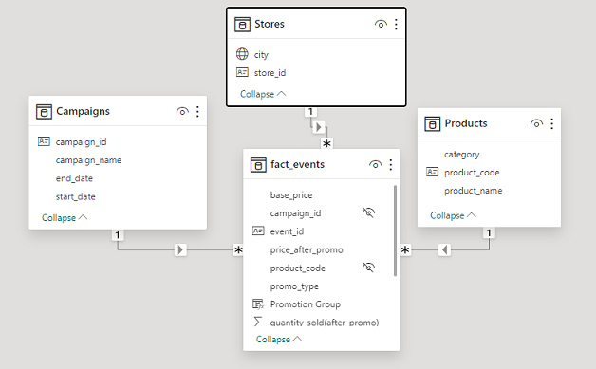
Codebasics challenge #9
Data Model

Slide 4
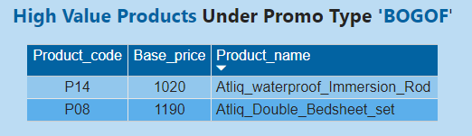
Codebasics challenge #9
Business Request 1
Provide a list of products whose base price is greater than 500 and that are featured in promo type ‘BOGOF’.
These were the high value products being heavily discounted .

Slide 5
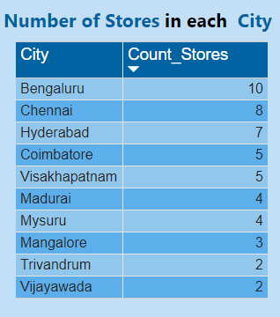
Codebasics challenge #9
Business Request 2
Generate a report that provides an overview of the number of stores in each city.

Slide 6
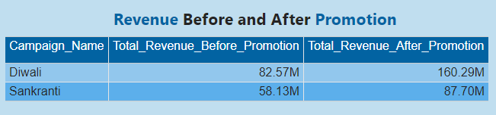
Codebasics challenge #9
Business Request 3
Generate a report that displays each campaign long with the total revenue generated before and after promotion.
More revenue was generated during Diwali than Sankranti.

Slide 7
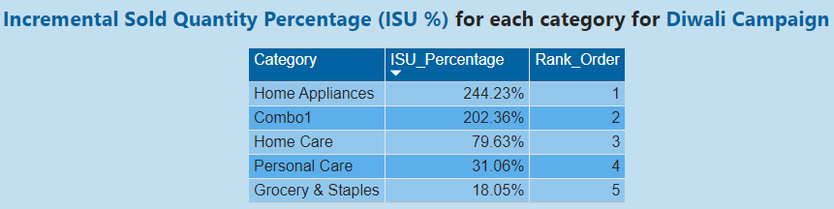
Codebasics challenge #9
Business Request 4
Produce a report that calculates the Incremental Sold Units(ISU %) for each category for Diwali Campaign. Additionally provide rankings for the categories based on the ISU%

Slide 8
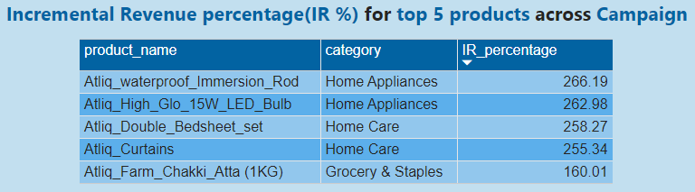
Codebasics challenge #9
Business Request 5
Create a report featuring top 5 products, ranked by Incremental Revenue(IR%), across all campaigns.

Slide 9
Codebasics challenge #9
Key Insights from the Dashboard
Bengaluru , Chennai and Hyderabad are the top performing cities as they had the highest number of stores being 10,8,7 respectively.
In all the stores highest Incremental Revenue is backed by products under promotion type ‘500 Cashback’ and ‘BOGOF’.
The difference in the high performing and low performing stores was the units of goods sold.

Slide 10
Codebasics challenge #9
Key Insights from the Dashboard
Promotion Type ‘500 Cashback’ backed the most incremental revenue followed by ‘BOGOF ‘ which brought the highest quantity sold while the discount based promotions resulted in decremental revenue generation.

Slide 11
Codebasics challenge #9
Key Insights from the Dashboard
Diwali
The product which was most sold and backed the highest incremental revenue was ‘Altiq_Home_Essentials belonging to category ‘combo1’.
One of the reason could be that Diwali brings in the tradition of deep cleaning the homes to welcome the goddess of wealth and prosperity .
This product also comes under the promotion type ‘500 Cashback’.

Slide 12
Codebasics challenge #9
Key Insights from the Dashboard
Sankranti –
The highest selling category was groceries and staples . One of the reason could be People generally eat and party together to celebrate .
But interestingly only those products in groceries and staple that come under the promotional type ‘BOGOF’ were demanded the most.
Whereas products under discount based promotion type performed negatively.

Slide 13
Key Insights from the Dashboard
During Diwali Altiq_sunflower_oil and Altiq_farm_chakki_atta generated the least incremental revenue % . While the same products were the top performing ones in Sankranti . The reason could be in Diwali these products were under ‘25% off’ promotional category and in Sankranti they were under ‘BOGOF’ So people clearly preferred BOGOF over discount based promotion type.

Slide 14
Codebasics challenge #9
Recommendation
It can be clearly seen from the analysis that people lured more towards products under promotional categories ‘BOGOF’ and ‘500 Cashback’ .
Reason could be customers find them to be more rewarding. Therefore for the next promotional period AltiQ Mart should focus on similar promotional types like
Buy2get1free
Gift with purchase
Store Credit points
Cash Vouchers

Slide 15
Codebasics challenge #9
Thank you
I would like to thank Dhaval Patel and Hemanand Vadivel and the codebasics team .

